Slide 1
2. FNNs and Backpropagation
2.1 Multilayer Feedforward Networks
2.2 Backpropagation algorithm
2.3 Working with backpropagation
2.4 Advanced algorithms
2.5 Performance of multilayer perceptrons

Slide 2
Generalization
Neural network is able to generalize:
If input-output mapping computed by the network is correct for test data
Test data were not used during training
Test data are from the same population as training data
If correct network response is given for inputs that are slightly different than the training examples
Overfitting Good generalization

Slide 3
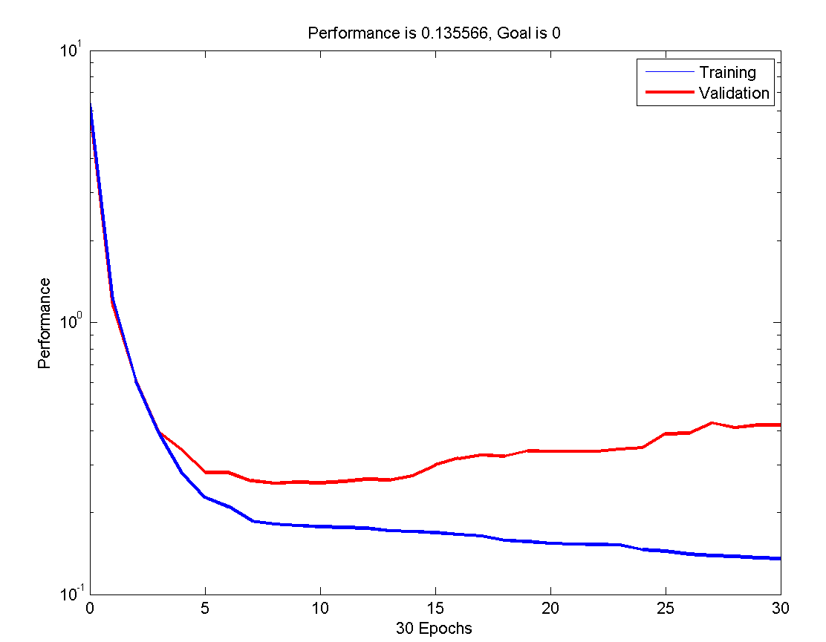
Improving generalization
Methods to improve generalization
Keeping the network small
Early stopping
Regularization
Early stopping
Available data are divided into three sets:
Training set – used to train the network
Validation set – used for early stopping, when the error starts to increase
Test set – used for final estimation of network performance and comparison of various models
Early stopping

Slide 4
Regularization
Improving generalization by regularization
Modifying performance function
with the mean sum of squares of network weights and biases
thus obtaining a new performance function
Using this performance function, the network will have smaller weights and biases, and this forces the network response to be smoother and less likely to overfit

Slide 5
Limitations of backpropagation
Some properties of backpropagation do not guarantee the algorithm to be universally useful:
Long training process
Possibly due to the non-optimum learning rate (advanced algorithms address this problem)
Network paralysis
Combination of sigmoidal activation and very large weights can decrease gradients almost to zero (vanishing gradient problem) → training is almost stopped
Local minima
Error surface of a complex network can be very complex, with many hills and valleys
Gradient methods can get trapped in local minima
Solutions: probabilistic learning methods (simulated annealing, ...)
Notes:
See also: https://en.wikipedia.org/wiki/Vanishing_gradient_problem

Slide 6
2.4 Advanced algorithms
Basic backpropagation is slow
Adjusts the weights in the steepest descent direction (negative of the gradient) in which the performance function is decreasing most rapidly
It turns out that, although the function decreases most rapidly along with the negative of the gradient, this does not necessarily produce the fastest convergence
Advanced algorithms based on heuristics
Developed from an analysis of the performance of the standard steepest descent algorithm
Momentum technique
Variable learning rate backpropagation
Resilient backpropagation
Numerical optimization techniques
Application of standard numerical optimization techniques to network training
Quasi-Newton algorithms
Conjugate Gradient algorithms
Levenberg-Marquardt algorithm

Slide 7
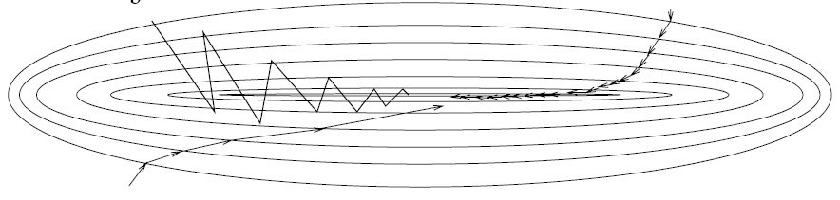
Momentum
A simple method of increasing learning rate yet avoiding the danger of instability
Modified delta rule by adding momentum term
Momentum constant
Accelerates backpropagation in steady downhill directions
Large learning rate
(oscillations)
Small learning rate
Learning with momentum

Slide 8
Variable learning rate η(t)
Another method of manipulating learning rate and momentum to accelerate backpropagation
Possible parameter values:
after weight update
if error decreases
If error increases less than ζ
If error increases more than ζ
weight update is accepted
learning rate is increased η(t+1) = ση(t), σ >1
if momentum has been previously reset to 0, it is set to its original value
weight update is accepted
learning rate is not changed η(t+1) = η(t),
if momentum has been previously reset to 0, it is set to its original value
weight update is discarded
learning rate is decreased η(t+1) = ρη(t), 0<ρ<1
momentum is reset to 0
Notes:
zeta, rho, eta, sigma

Slide 9
Resilient backpropagation
Slope of sigmoid functions approaches zero as the input gets large
This causes a problem when you use the steepest descent to train a network
Gradient can have a very small magnitude → also changes in weights are small, even though the weights are far from their optimal values
Resilient backpropagation
Eliminates these harmful effects of the magnitudes of the partial derivatives
Only sign of the derivative is used to determine the direction of weight update, the size of the weight change is determined by a separate update value
Resilient backpropagation rules:
Update value for each weight and bias is increased by a factor δ_{inc} if the derivative of the performance function concerning that weight has the same sign for two successive iterations
Update value is decreased by a factor δ_{dec} if the derivative concerning that weight changes sign from the previous iteration
If the derivative is zero, then the update value remains the same
If weights are oscillating, the weight change is reduced

Slide 10
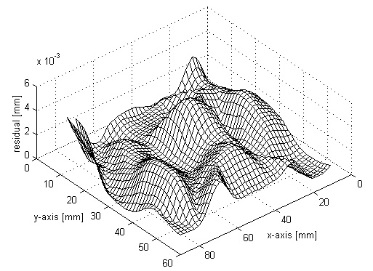
Numerical optimization (1/3)
Supervised learning as an optimization problem
Error surface of a multilayer perceptron, expressed by instantaneous error energy E(n), is a highly nonlinear function of synaptic weight vector w(n)
E(w₁,w₂)
w₂
w₁

Slide 11
Numerical optimization (2/3)
Expanding the error energy by a Taylor series
Local gradient
Hessian matrix

Slide 12
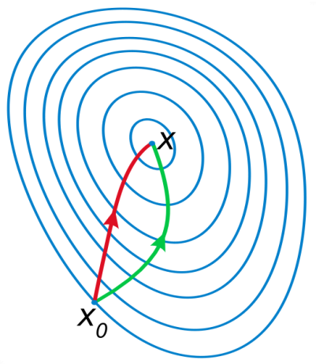
Numerical optimization (3/3)
Steepest descent method (backpropagation)
Weight adjustment proportional to the gradient
Simple implementation, but slow convergence
Significant improvement by using higher-order information
Adding momentum term → a crude approximation to use second-order information about error surface
Quadratic approximation about error surface → The essence of Newton’s method
H⁻¹ is the inverse of the Hessian matrix
gradient descent
Newton’s method
Notes:
http://en.wikipedia.org/wiki/Newton's_method_in_optimization
http://en.wikipedia.org/wiki/Newton's_method

Slide 13
Quasi-Newton algorithms
Problems with the calculation of the Hessian matrix
Inverse Hessian H⁻¹ is required, which is computationally expensive
Hessian has to be nonsingular which is not guaranteed
Hessian for a neural network can be rank deficient
No convergence guarantee for non-quadratic error surface
Quasi-Newton method
Only requires a calculation of the gradient vector g(n)
The method estimates the inverse Hessian directly without matrix inversion
Quasi-Newton variants:
Davidon-Fletcher-Powell algorithm
Broyden-Fletcher-Goldfarb-Shanno algorithm ... best form of Quasi-Newton algorithm!
Application for neural networks
The method is fast for small neural networks

Slide 14
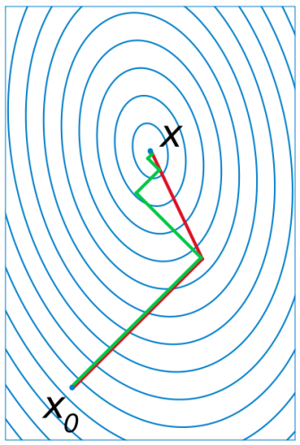
Conjugate gradient algorithms
Conjugate gradient algorithms
Second-order methods, avoid computational problems with the inverse Hessian
Search is performed along the conjugate directions, which produces generally faster convergence than steepest descent directions
In most of the conjugate gradient algorithms, the step size is adjusted at each iteration
A search is made along the conjugate gradient direction to determine the step size that minimizes the performance function along that line
Many variants of conjugate gradient algorithms
Fletcher-Reeves Update
Polak-Ribiére Update
Powell-Beale Restarts
Scaled Conjugate Gradient
Application for neural networks
Perhaps the only method suitable for large-scale problems (hundreds or thousands of adjustable parameters) → well suited for multilayer perceptrons
gradient descent
conjugate gradient

Slide 15
Levenberg-Marquardt algorithm
Levenberg-Marquardt algorithm (LM)
Similar to quasi-Newton methods, LM algorithm was designed to approach second-order training speed without having to compute the Hessian matrix
When the performance function has the form of a sum of squares (typical in neural network training), then the Hessian matrix H can be approximated by Jacobian matrix J
where Jacobian matrix contains first derivatives of the network errors with respect to the weights
Jacobian can be computed through a standard backpropagation technique that is much less complex than computing the Hessian matrix
Application for neural networks
Algorithm appears to be the fastest method for training moderate-sized feedforward neural networks (up to several hundred weights)
Notes:
LM method is a compromise between Newton’s method and gradient descent

Slide 16
Advanced algorithms summary
Practical hints
Variable learning rate algorithm is usually much slower than the other methods
Resilient backpropagation method is very well suited for pattern recognition problems
Function approximation problems, networks with up to a few hundred weights: Levenberg-Marquardt algorithm will have the fastest convergence and very accurate training
Conjugate gradient algorithms perform well over a wide variety of problems, particularly for networks with a large number of weights (modest memory requirements)

Slide 17
2.5 Performance of multilayer perceptrons
Approximation error is influenced by
Learning algorithm used ... (discussed in the last section)
This determines how good the error on the training set is minimized
Number and distribution of learning samples
This determines how good training samples represent the actual function
Number of hidden units
This determines the expressive power of the network. For smooth functions only a few hidden units are needed, for wildly fluctuating functions more hidden units will be needed
Notes:
Krose & Van der Smagt

Slide 18
Number of learning samples
Function approximation example y = f(x)
Training set with 4 samples has a small training error but gives a very poor generalization
Training set with 20 samples has higher training error but generalizes well
Low training error is no guarantee for a good network performance!
4 learning samples 20 learning samples

Slide 19
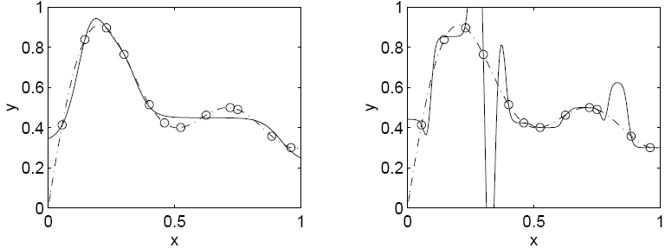
Number of hidden units
Function approximation example y=f(x)
A large number of hidden units leads to a small training error but not necessarily to a small test error
Adding hidden units always leads to a reduction of the training error
However, adding hidden units will first lead to a reduction of test error but then to an increase of test error ... (peaking effect, early stopping can be applied)
5 hidden units 20 hidden units

Slide 20
Size effect summary
Number of training samples Number of hidden units
Error
rate
Error
rate
Optimal number of
hidden neurons
Test set
Test set
Training set
Training set
Number of training samples Number of hidden units

